Slide 1
CS 3308 Final Presentation
Team 2: Space Monkeys
By: Michael Becker,
Cyro Freire De Lima,
David Hughes,
Dylan Kayyem,
Travis Byrne

Slide 2
Vision and Description of our Product
Vision Statement:
Blood is meant for circulation!
The vision of the Space Monkeys is to create a blood bank management application with the goal of safely providing as many patients as possible with clean, unexpired, compatible blood so that they have the best chance of a positive health outcome if they need a blood transfusion.
Description:
Our app delivers a simple and easy-to-use interface that allows doctors and hospital staff to manage blood efficiently and accurately. From quickly getting the information needed to care for patients who need a transfusion, to managing the blood stores across a group of hospitals, to viewing any complications that may arise from a particular blood donation, our app has you covered!

Slide 3
Tools

Slide 4
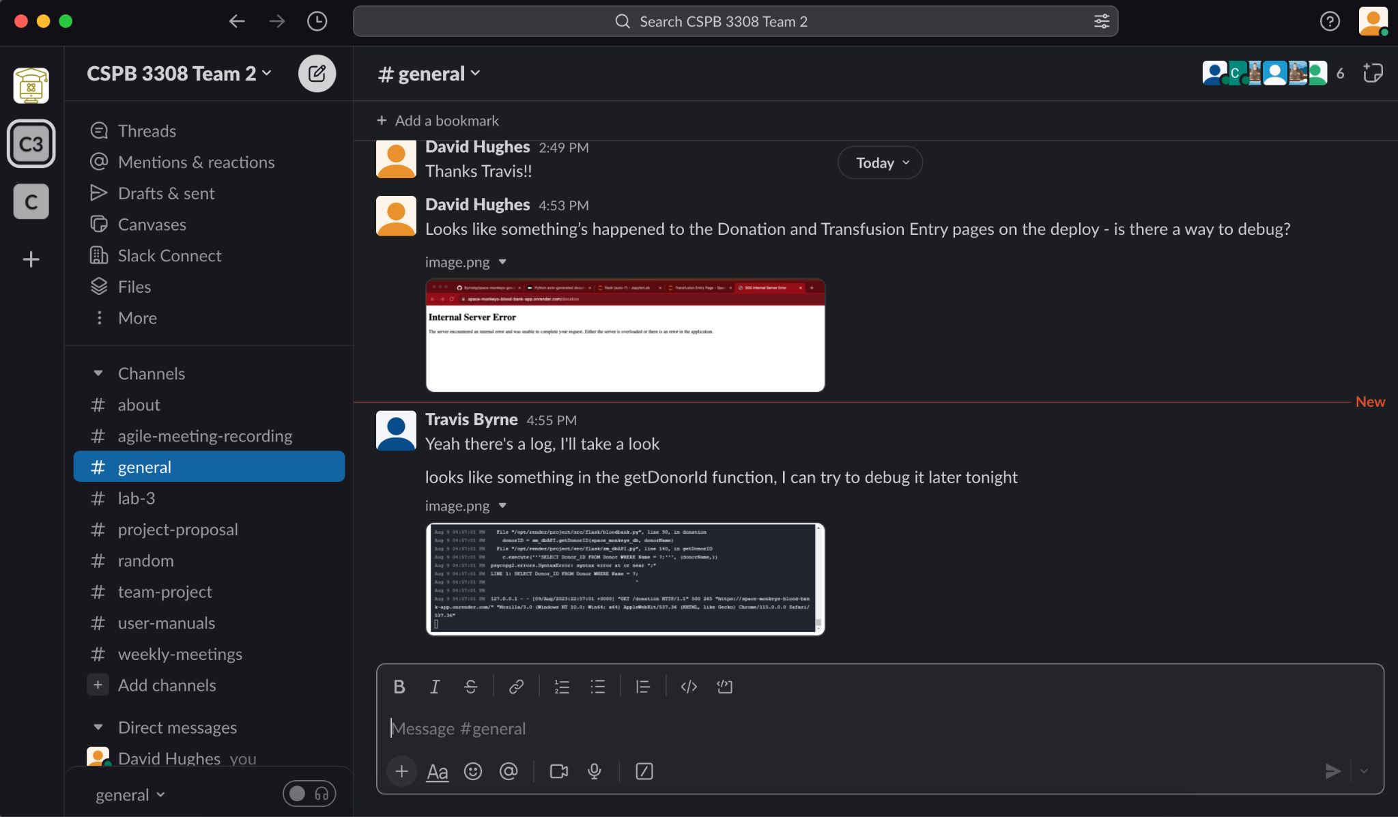
Team Communication: Slack
Purpose:
Way for team members to communicate asynchronously with each other about anything related to the project
Provided a written record of all the communications of the team that was searchable and we could refer back to
Evaluation:
Slack was essential to the project’s success as it enabled a constant flow of communication throughout the the week in between the weekly Zoom meetings

Slide 5
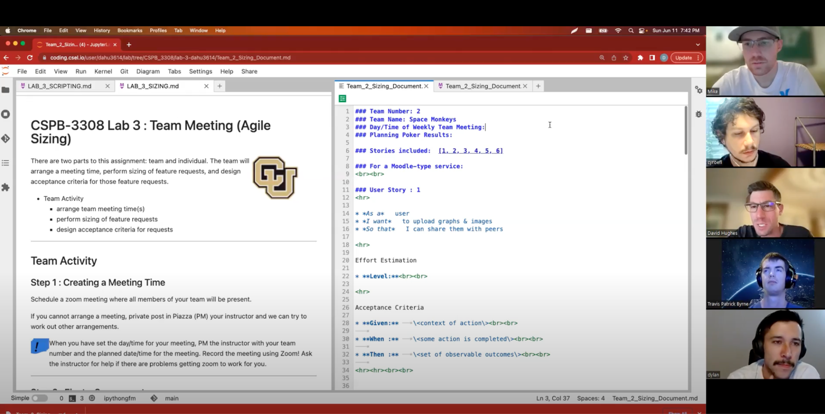
Team Communication: Zoom
Purpose:
Way for team members to hold weekly project meetings
Evaluation:
Zoom was essential to the project’s success as it allowed discussion of more complex topics and back-and-forth discussion than Slack
The weekly Zoom meetings helped keep everyone on the same page and allowed us to build consensus on key project decisions

Slide 6
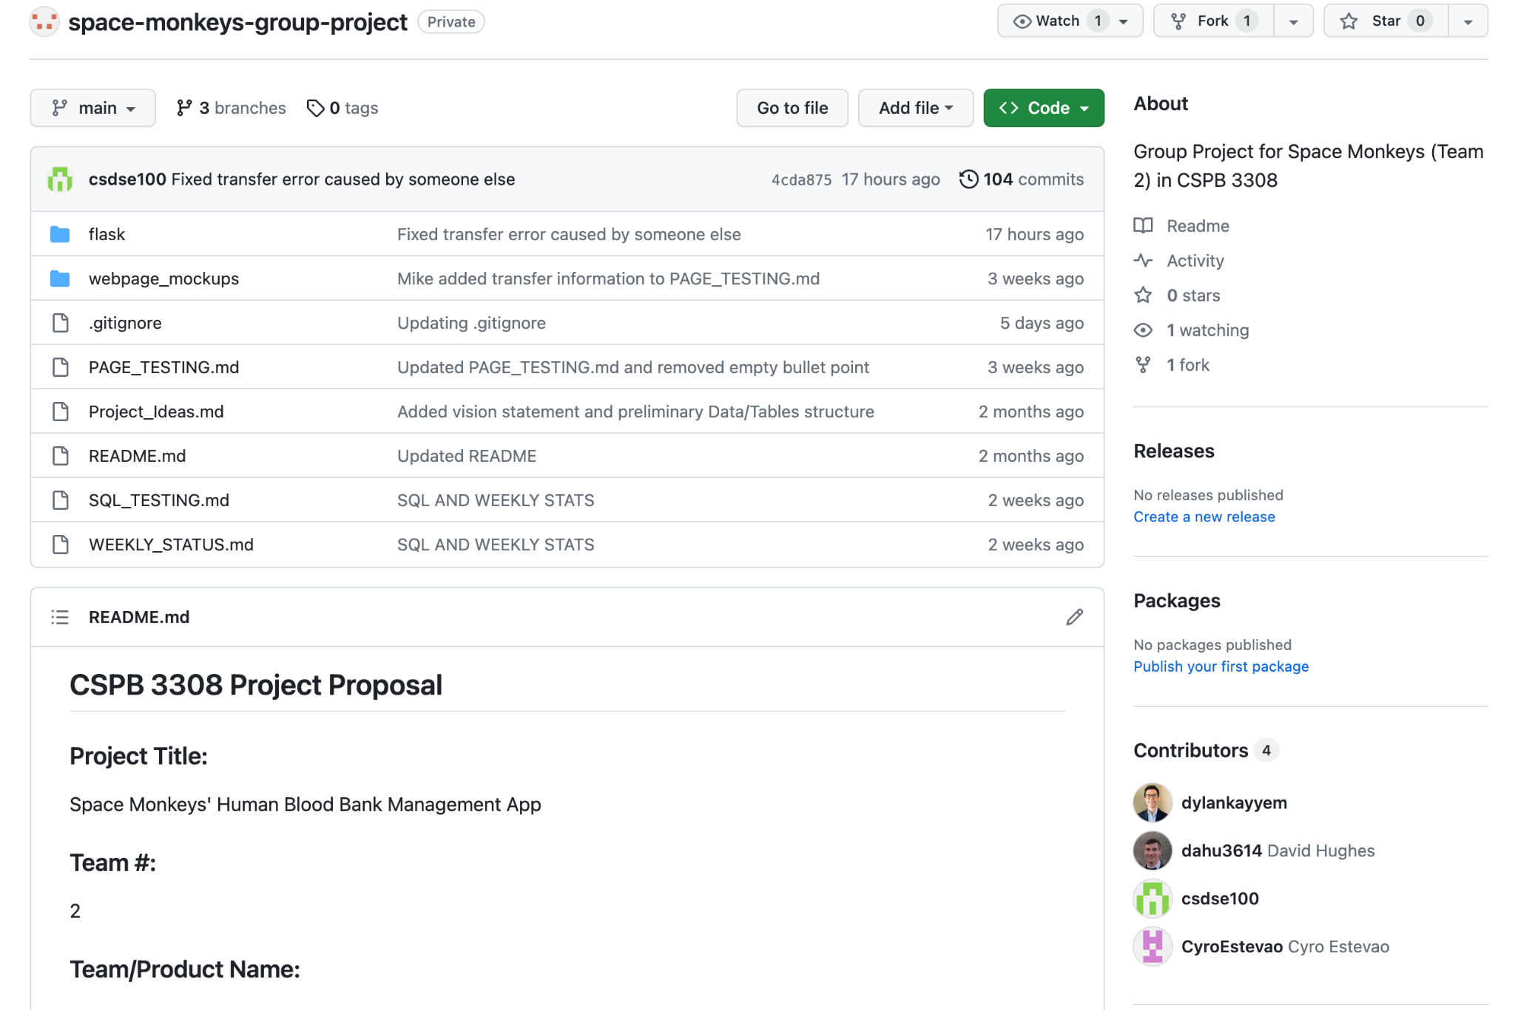
Version Control: Github
Purpose:
Provide a central source of truth for the latest version of the code
Allow team members to easily collaborate on code
Provide a history of changes made to the project over time as features are added / changed
Evaluation:
Github was essential to the project’s success as it allowed everyone to contribute to the remote repository, track the evolution of the project over time, and ensure everyone was on the same page

Slide 7
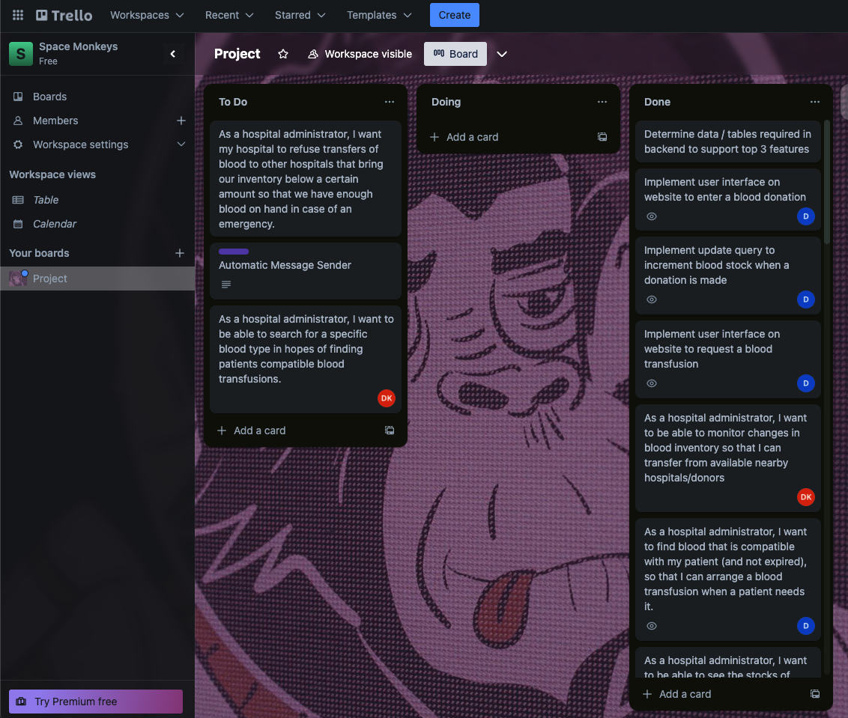
Project Tracker: Trello
Purpose:
Kanban Method - develop and track implementation of User Stories
Provide a method of communication as to who is working on which feature - Developers choose a task and update the board
Provide a visualization of work completed / work remaining on project
Evaluation:
Good for brainstorming but hard to prioritize tasks without a Product Owner or customer
Slack became the de facto method of communicating who is working on what

Slide 8
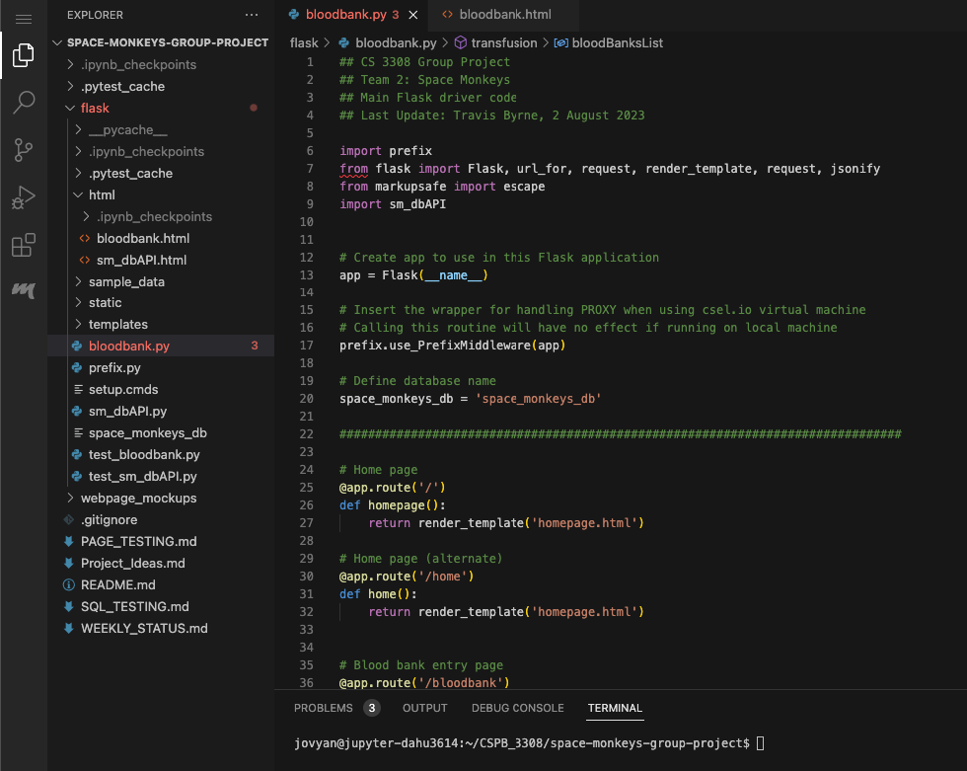
IDE: VSCode
Purpose:
Development environment for writing project code
Formatting makes it easier to read / debug code
Provide terminal for command line interface to run project code
Evaluation:
VSCode was not strictly essential, but was extremely helpful to make the process of coding faster and easier

Slide 9
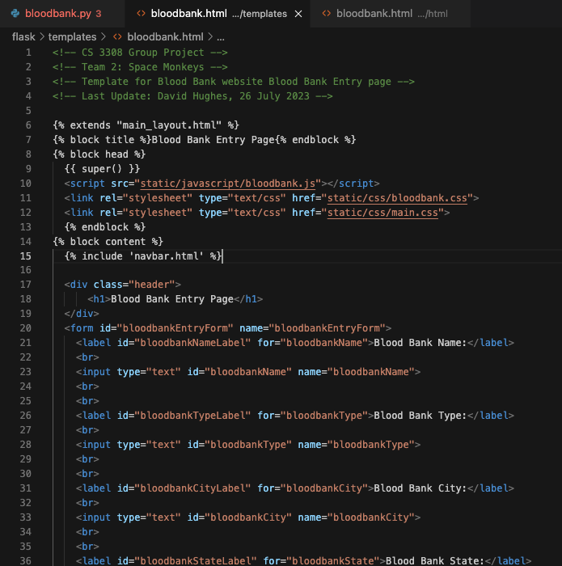
Framework: Flask / Jinja
Purpose:
Provide a way to create and render HTML pages for the blood bank app
Template inheritance allowed us to break up the HTML pages into different components (header, footer, nav bar, content) and maintain a consistent structure of the application
Evaluation:
Flask was essential to the project’s success to be able to actually display the HTML pages of the app and connect the frontend to the backend

Slide 10
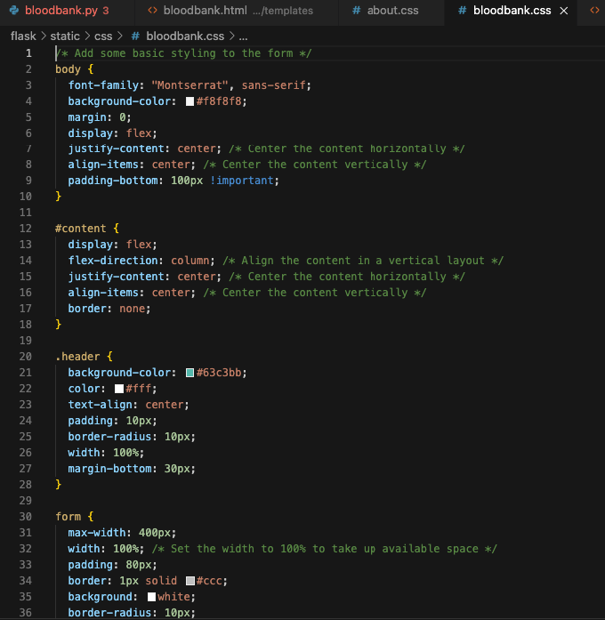
Styling: CSS
Purpose:
Provide a way to create the look and feel of the web app by giving style attributes to the different HTML elements
Evaluation:
CSS was essential to the project’s success to build a web app with a consistent look and feel

Slide 11
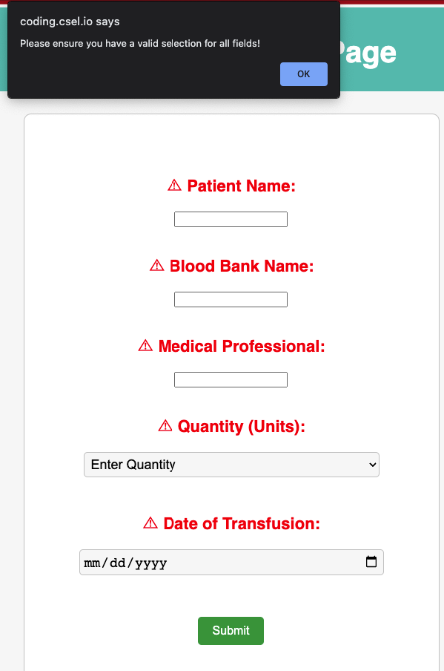
User Interactivity: Javascript
Purpose:
Provide a way to validate user input and dynamically change the web app pages without making additional calls to the backend
Ensure that only validated data (i.e. blood type, patient name, etc) is sent to the backend to be saved in the database
Evaluation:
Javascript allowed us to develop a more sophisticated and user friendly web application

Slide 12
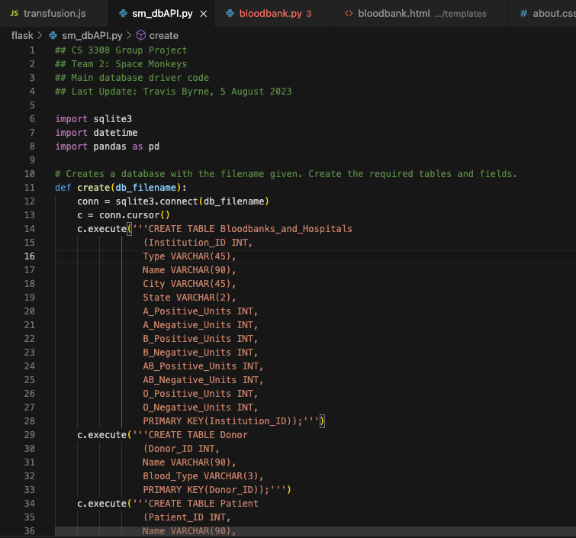
Database: SQLite / PostGres
Purpose:
Provide a way to store and query application data to allow the users to input and view blood bank data
Evaluation:
SQLite was essential to the project’s success as our main database as we were developing the app, but when we deployed the app we had to change our database to PostGres as this is what is used by Render

Slide 13
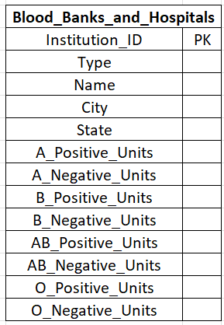
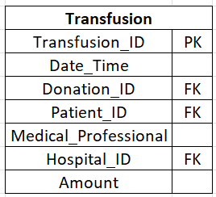
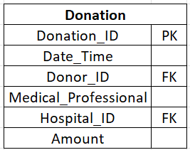
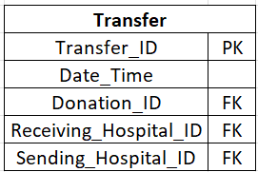
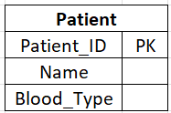
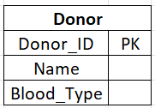
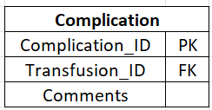
Database Schema

Slide 14
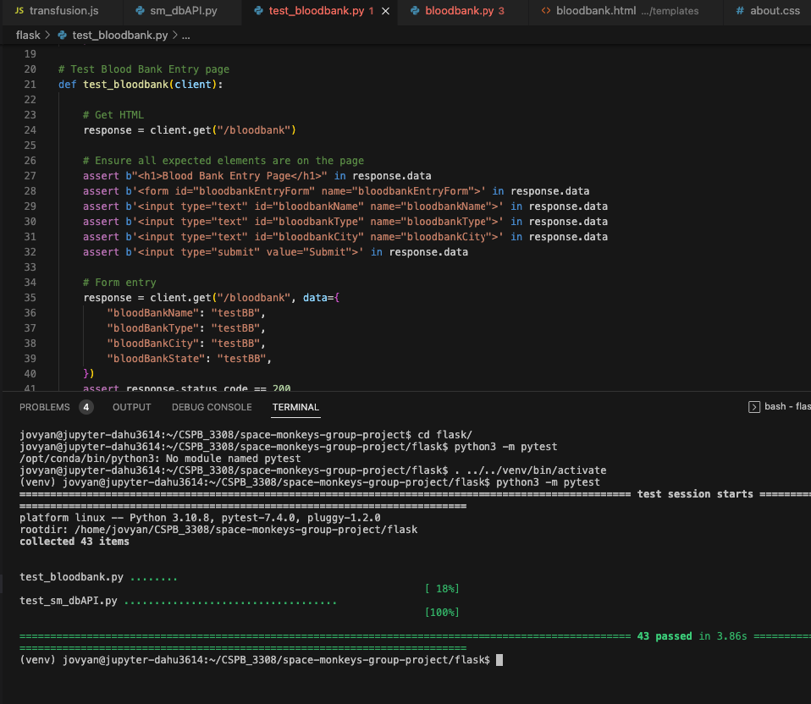
Testing: Pytest
Purpose:
Ensure that new project code preserved backwards compatibility (i.e. a new feature did not break something previously created)
Evaluation:
Writing good test code is an art - the value of the test code is what you put into it

Slide 15
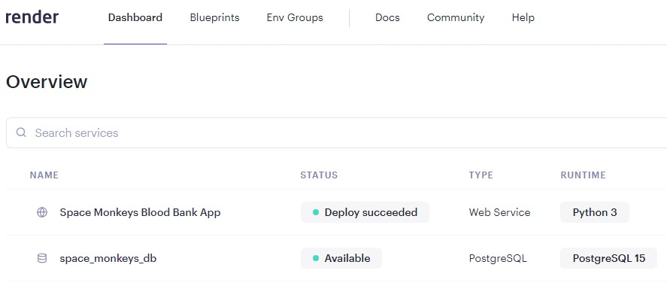
Deployment Environment: render
Purpose:
Free version of Web Service &, PostgreSQL database
Hosted on github
Repository & Deployment Management
Independent code branch named ‘deploy’
Evaluation:
Slow to deploy but very useful!
https://space-monkeys-blood-bank-app.onrender.com/
Notes:
Dylan’s Slide 1: Deployment Environment: Render
Thanks Mike, & good evening everyone! Today, I want to walk you through the deployment environment we chose for our app. We decided on 'Render' for a few pivotal reasons:
Purpose:
Render offers a generous free tier for its Web Service and PostgreSQL database. This made it a cost-effective solution for our project.
Efficiency:
The beauty of using Render is its seamless integration with GitHub. This means every time we commit a change to our code, Render automatically initiates the deployment process.
Repository & Deployment Management:
All our code is safely hosted on GitHub. And to ensure a clean and conflict-free deployment, we've dedicated an independent branch named 'deploy'. However, like all things, there's room for improvement. We noticed Render can be a tad slow in deployment. But its utility, in the grand scheme of things, is undeniable."

Slide 16
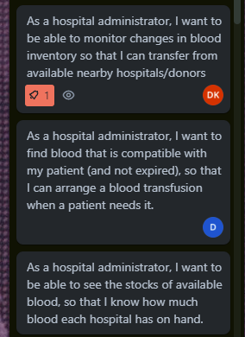
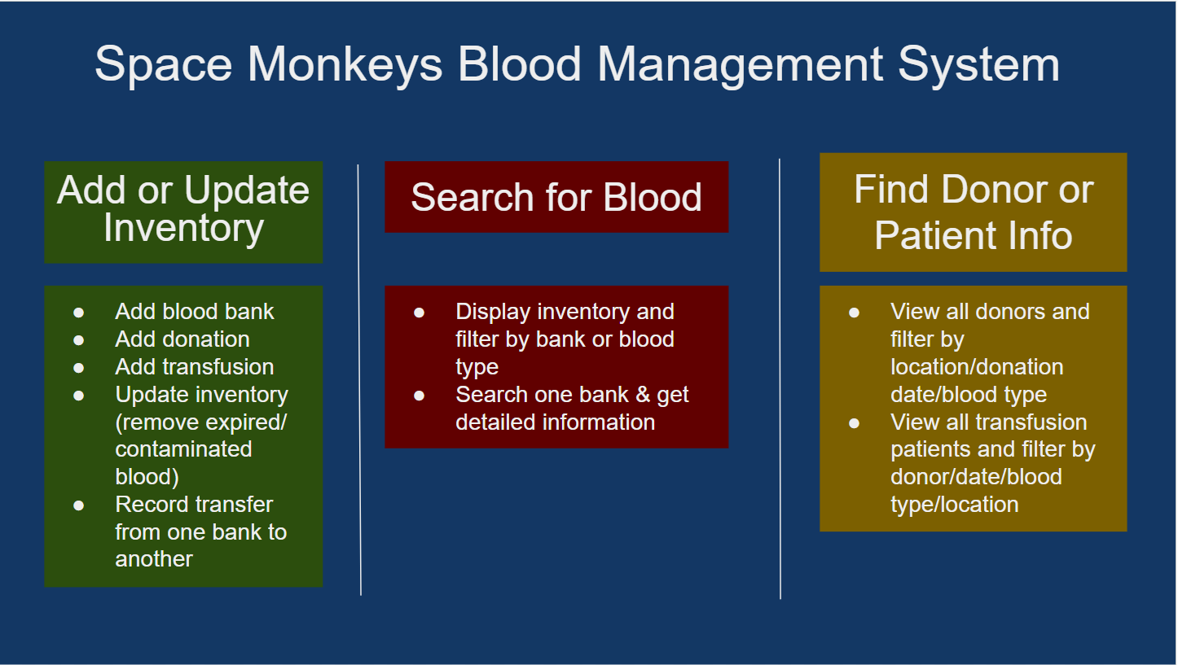
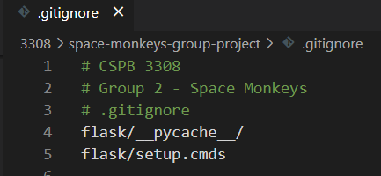
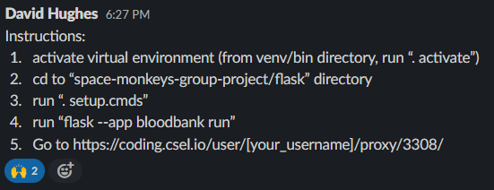
Challenges We Encountered,
How We Overcame Them &
How It Changed Our Plans
Code Integration
.gitignore & git rebase
Consistent Styling
Central Styling & HTML Templates
Dependency Management
Pandas & Pytest
Defining Our Target Audience
User Stories
Prioritizing Features
“Must-haves” vs. “Nice-to-have”
Notes:
Dylan’s Slide 2: Challenges, Solutions & Adaptations
Every project comes with its unique set of challenges. Here's a quick dive into some of the hurdles we faced and how we tackled them:
Code Integration:
Integrating code from different branches can often result in merge conflicts. We experienced this firsthand. To address this, we leveraged a '.gitignore' for pycache files and used 'git rebase' to ensure our database files were always up-to-date.
Consistent Styling:
Achieving uniformity in our site's CSS styling was another challenge. Our approach? We created a central styling page, ensuring every element drew from this core. Further, by utilizing HTML templates with inheritance, we managed to modularize our site into segments - think headers, footers, navigation bars, and content. Our pre-design phase also involved creating mock-ups, giving us a clearer picture of our site's desired appearance.
Dependency Management:
Our app relies on various packages like pandas and pytest. To sidestep compatibility issues, we actively ensured everyone had the necessary packages installed. Additionally, we posted clear installation and Flask app deployment instructions on Slack for easy reference.
Defining Our Target Audience:
Our initial dilemma was deciding our app's primary user – blood bank donors or administrators. However, after meticulously crafting our user stories, it was evident that our app best catered to administrators.
Prioritizing Features:
With a plethora of features to include, prioritization was key. We found success in segmenting our features into 'must-haves' and 'nice-to-haves', ensuring our app's primary functions were never compromised.
That's a wrap from my end. I'll now hand over the presentation to [cyro/travis/david] for further insights!

Slide 17

Demonstration

